Slide 1
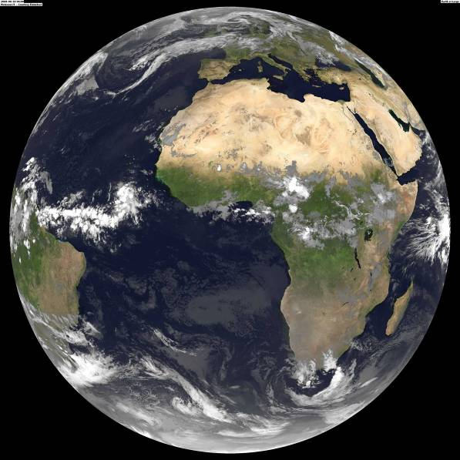
Earth Observation beyond Google Earth
Raymond Sluiter
Netherlands Space Office

Slide 2
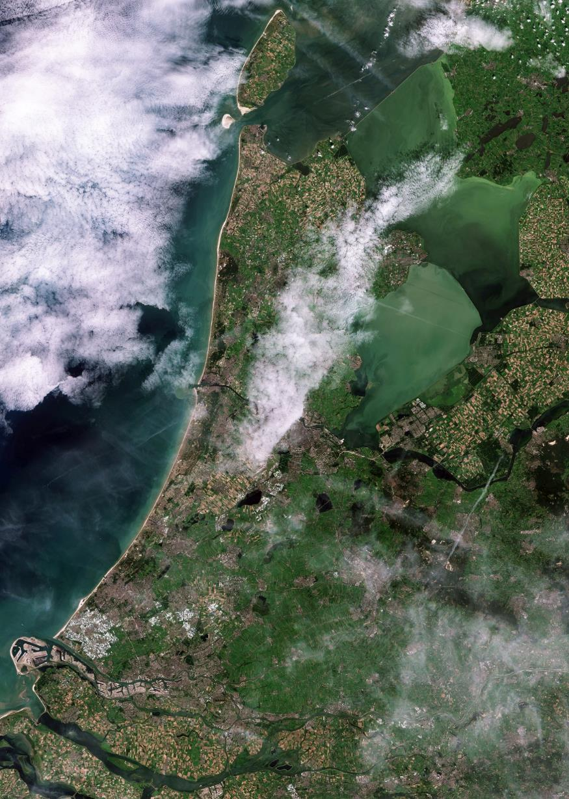
Outline
Introduction - Earth Observation & Copernicus
Copernicus Data Access
Data Access 4.0 & 4.1
Discussion

Slide 3
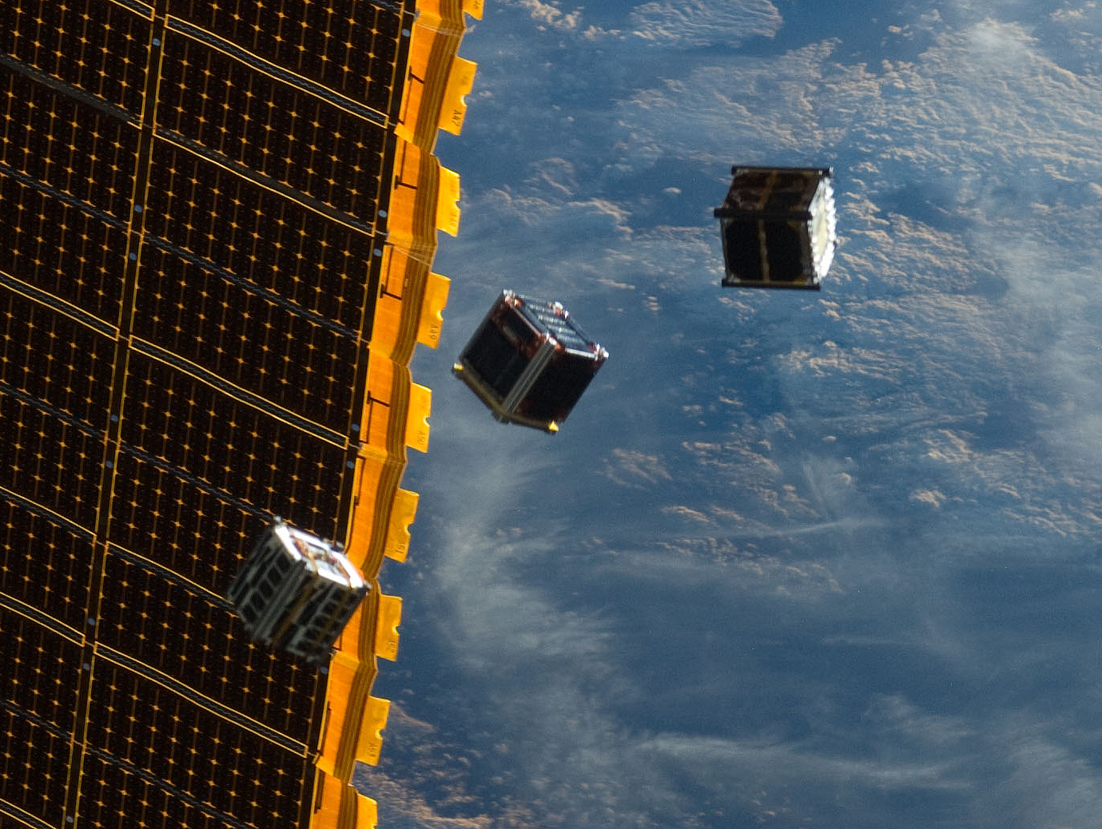

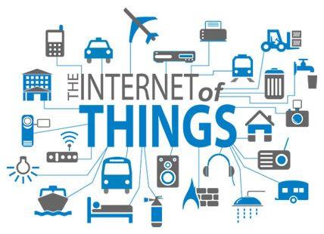
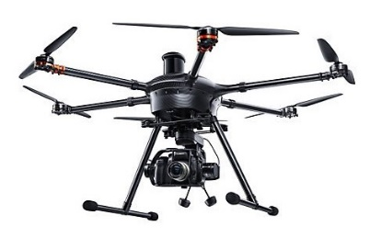

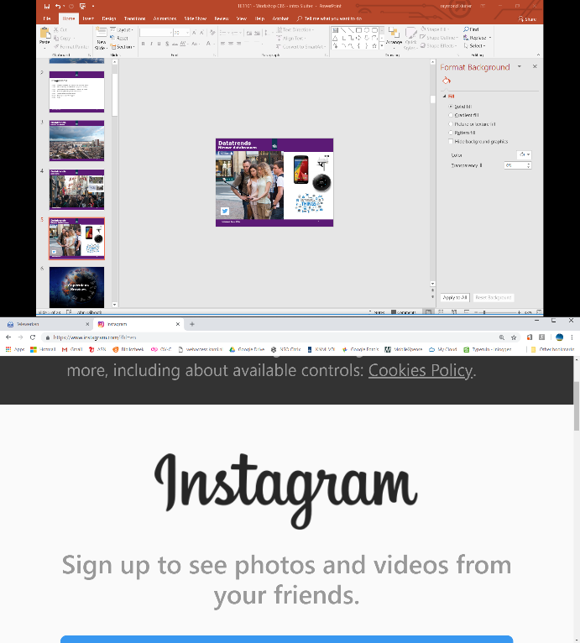
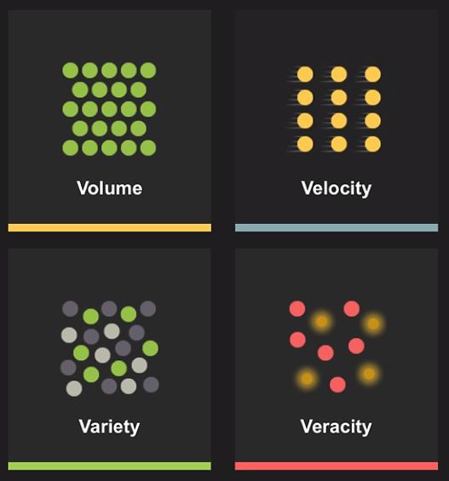
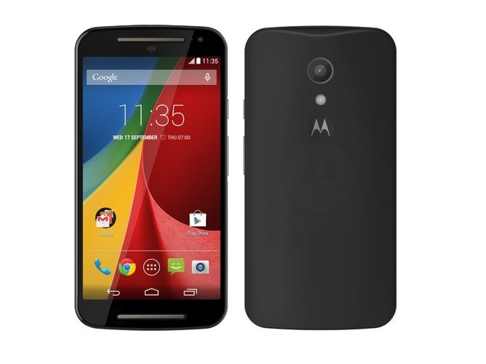
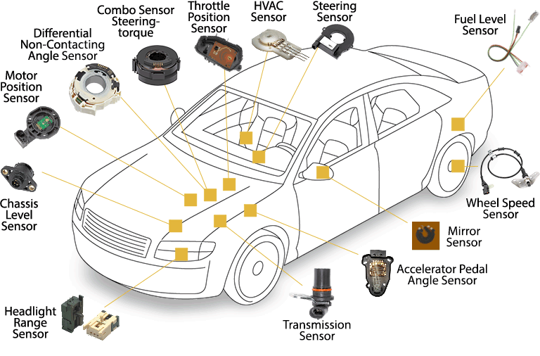
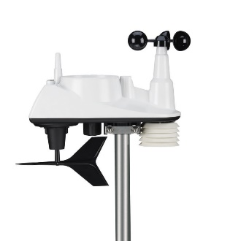
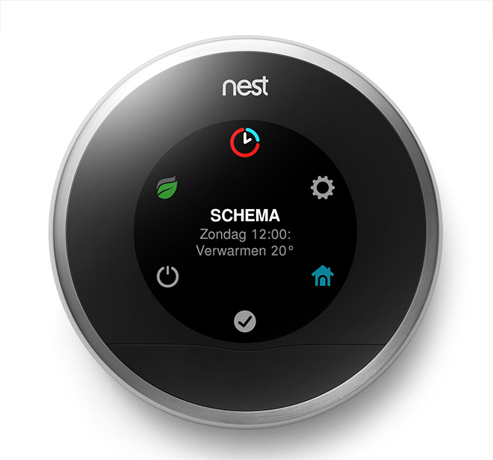
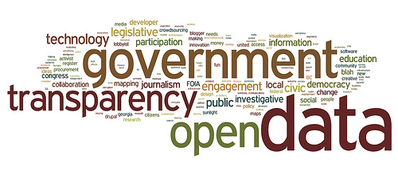

Slide 4

Sentinel-1 Radar (land & marine)
Sentinel-2 Optical (land)
Sentinel-3 Optical (land & marine)
Sentinel-4 Optical (atmosphere) 2021
Sentinel-5P Optical (atmosphere)
Sentinel-5 Optical (atmosphere) 2021
Sentinel-6 Altimeter (marine) 2020
Each Sentinel will have 4 units (A,B,C,D)
Free & Open Data, guaranteed until 2030+

Slide 5
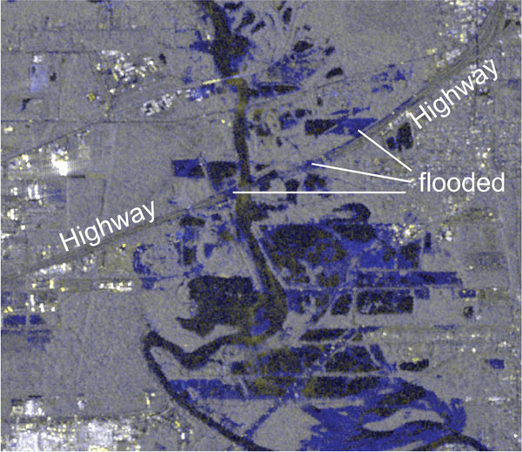
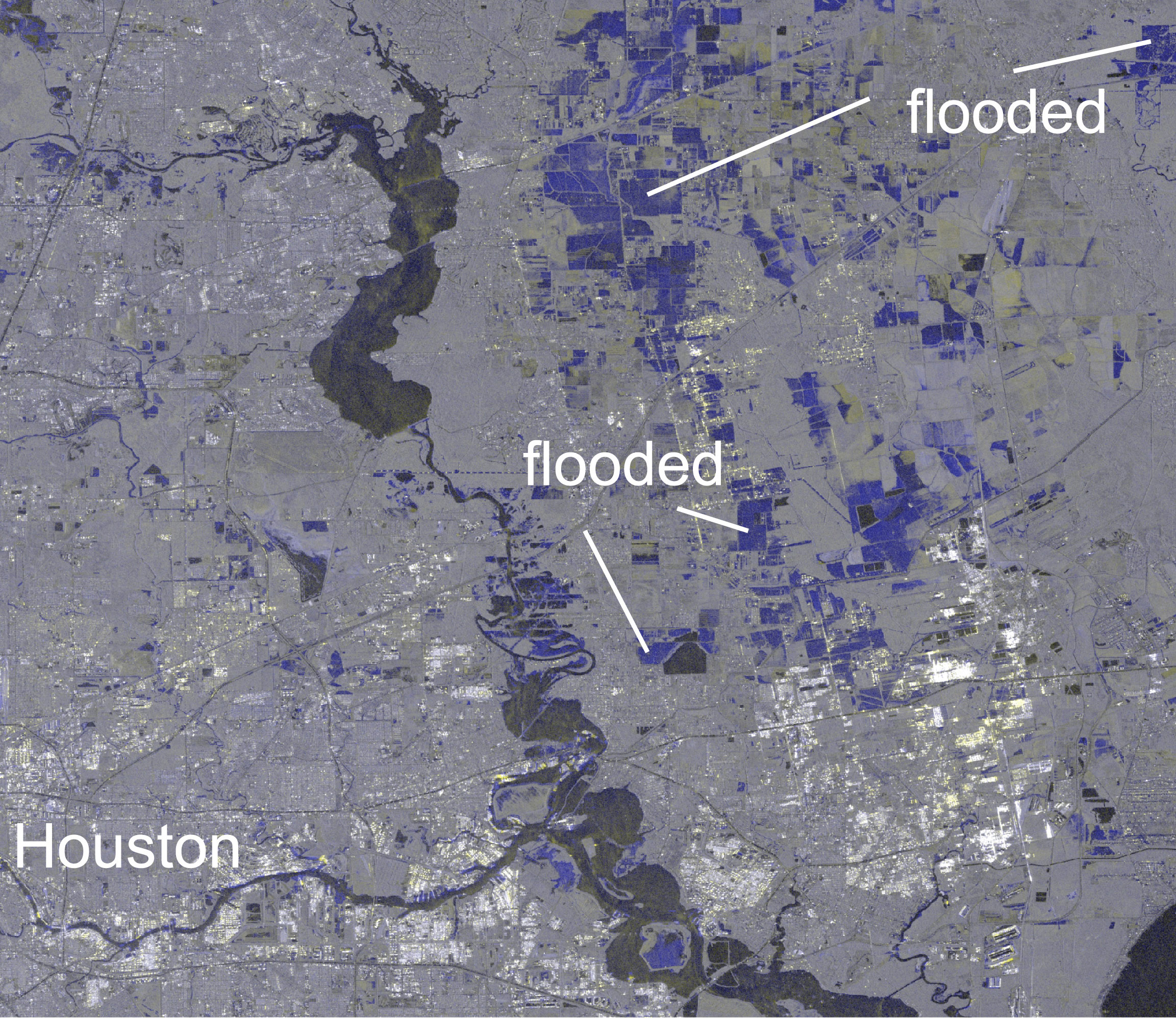
Sentinel 1
Hurricane Harvey Flooding
August 2017

Slide 6
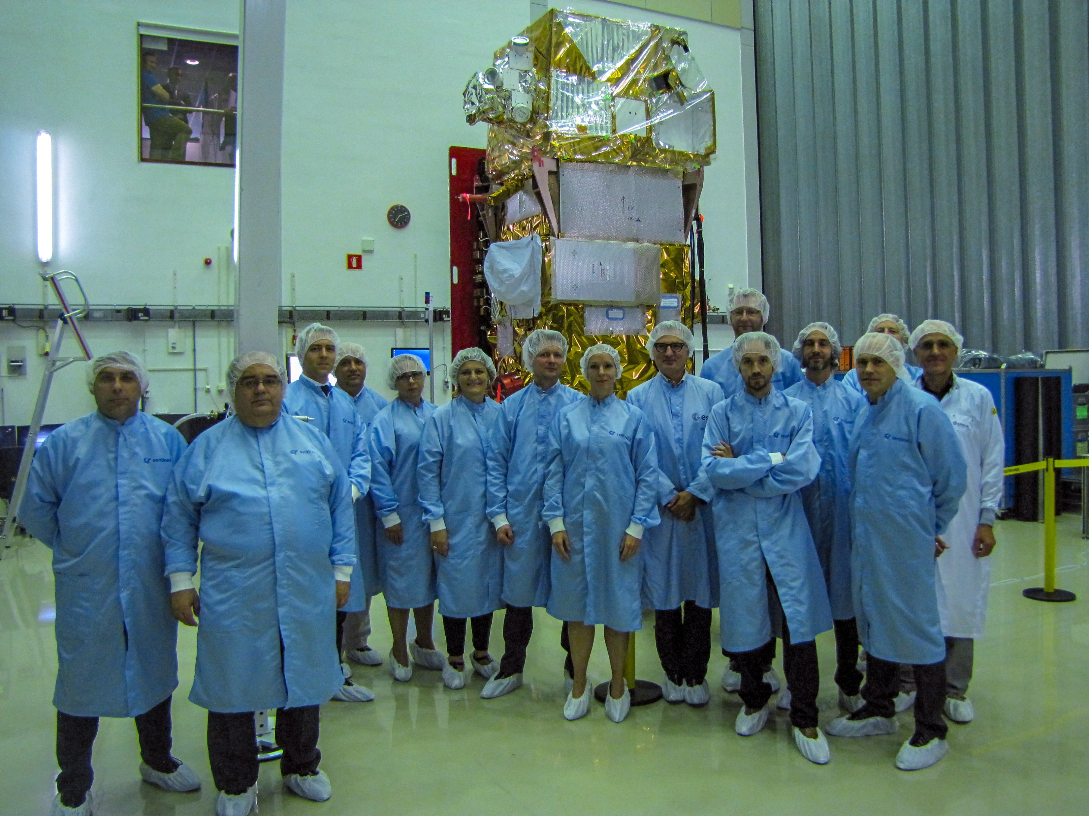
Sentinel 2
MSI: MultiSpectral Imager
13 bands VIS-NIR-SWIR 10-60 m.
Revisit time 3-5 days
Land cover & use

Slide 7
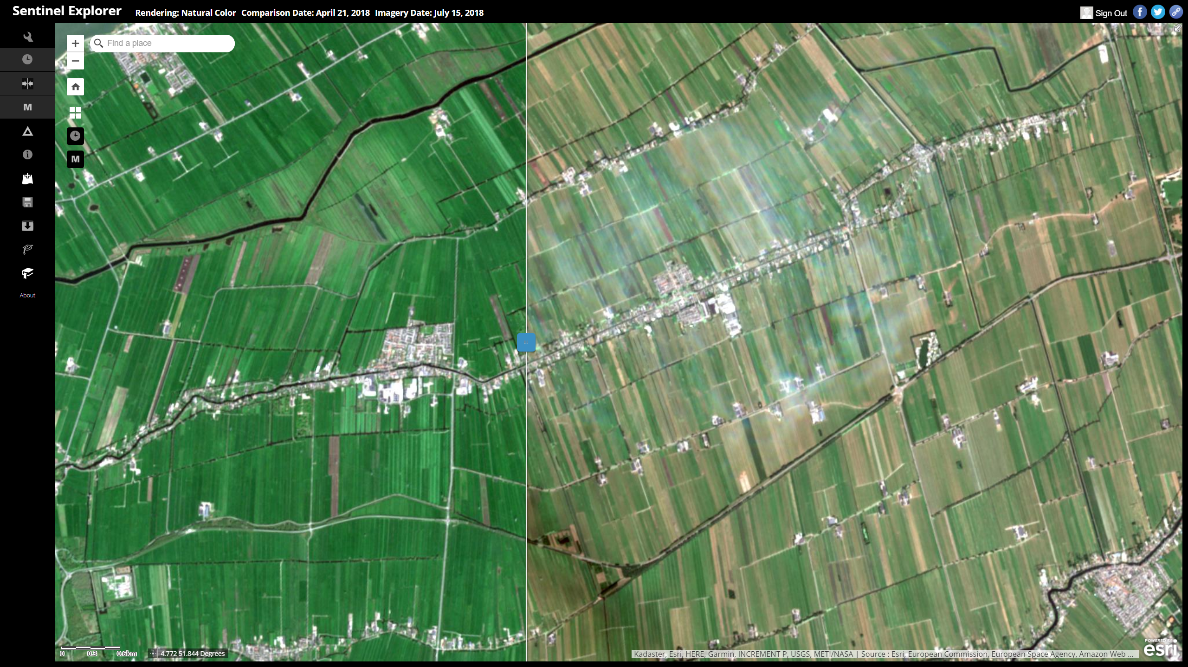
Sentinel 2 in ESRI Sentinel Explorer
Niels van der Vaart & Marcel de Rink ESRI

Slide 8
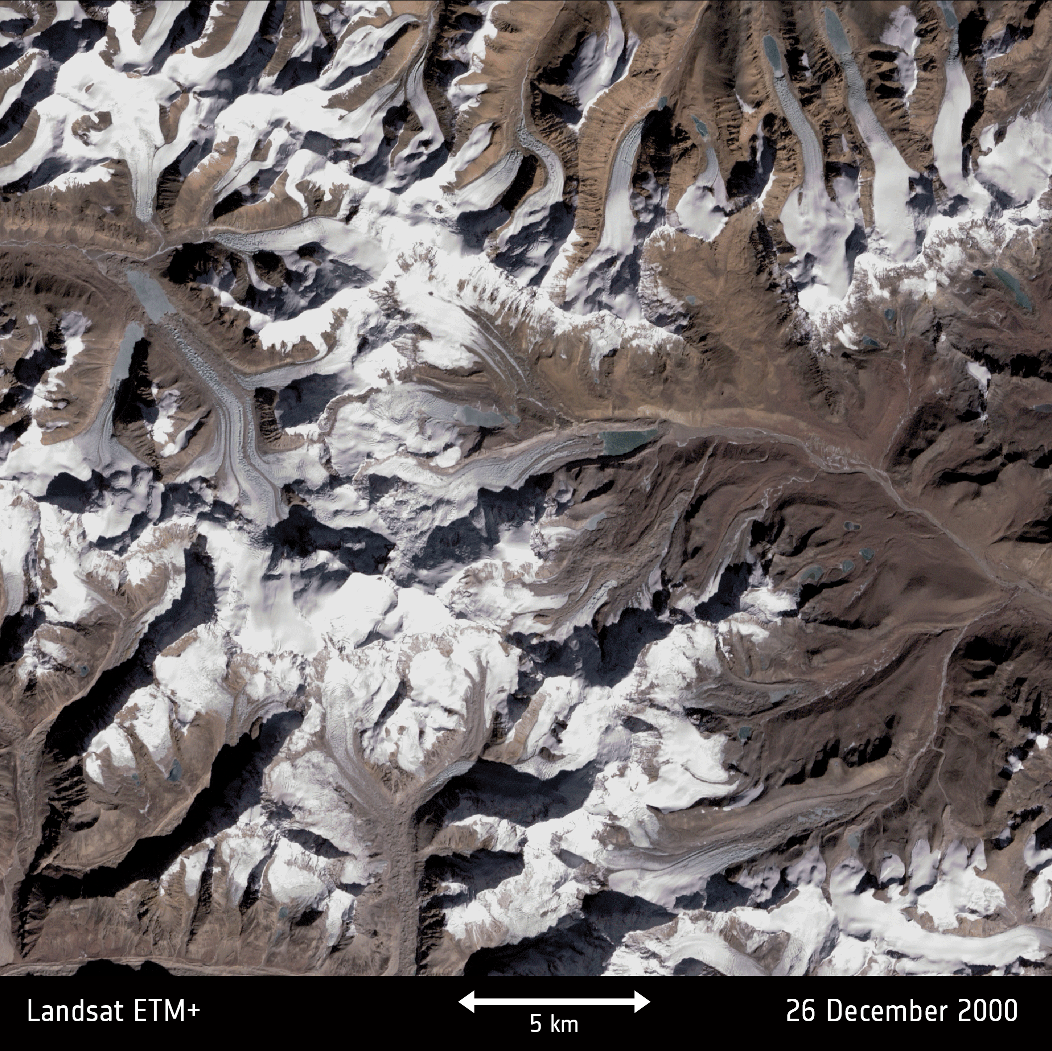
Sentinel 2 / Landsat 7
Glacial decline
Sikkim - northeast India

Slide 9
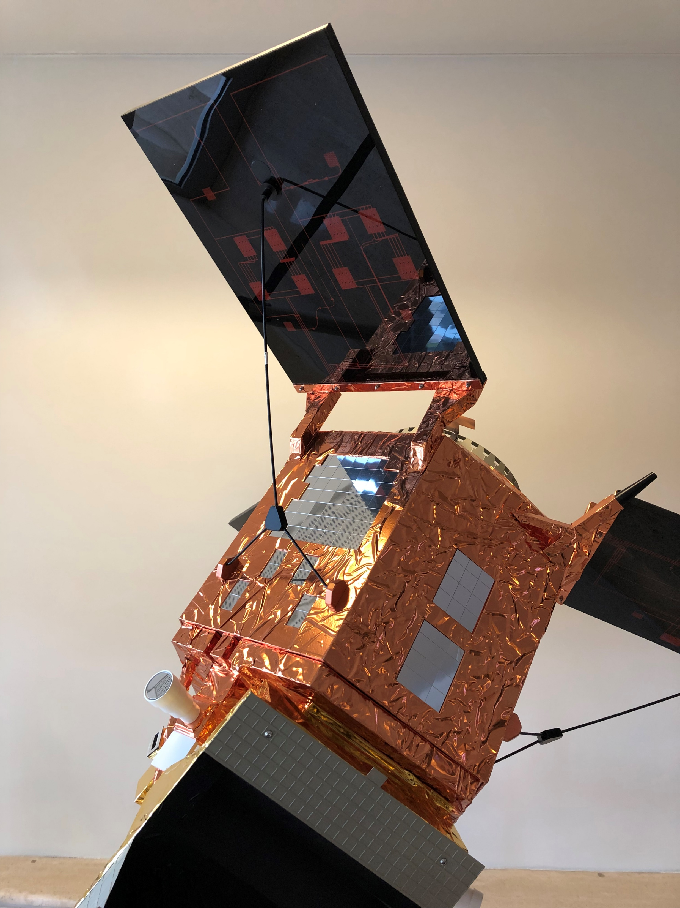
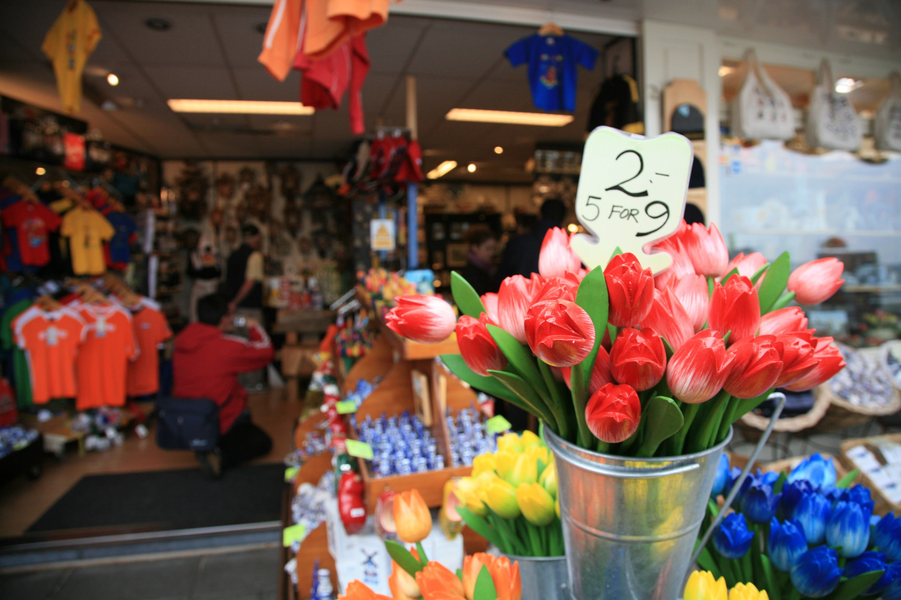
Sentinel 5P
TROPOMI instrument
O₃ SO₂ NO₂ CH₄ CO
Daily global
3.5*7 km.

Slide 10
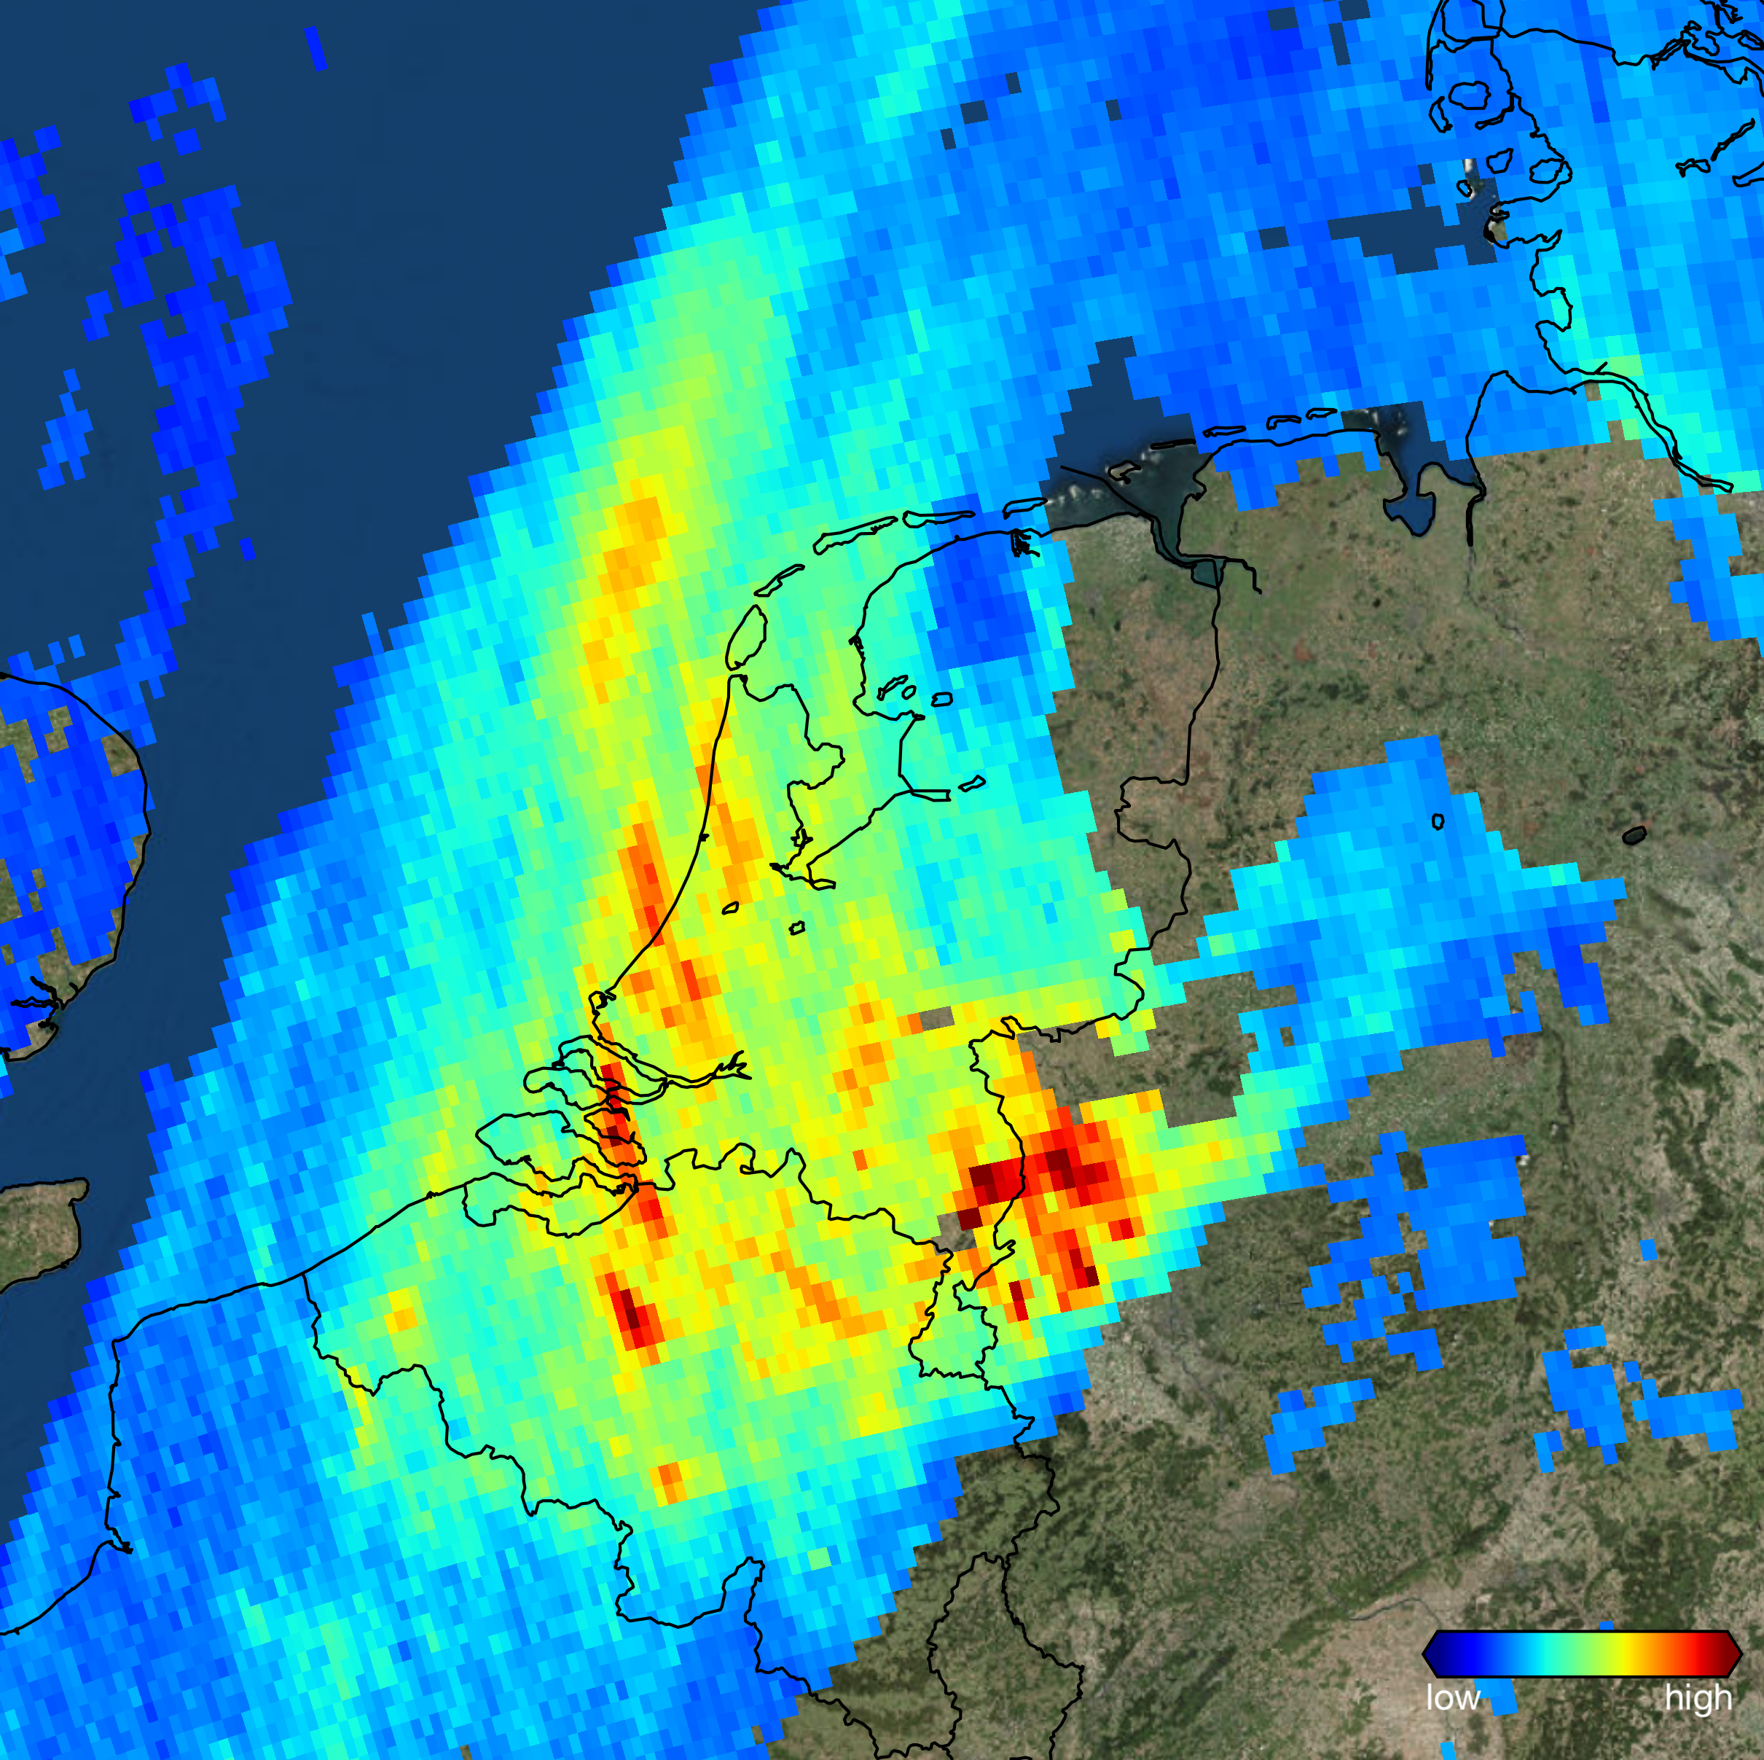
TROPOMI
NO₂

Slide 11
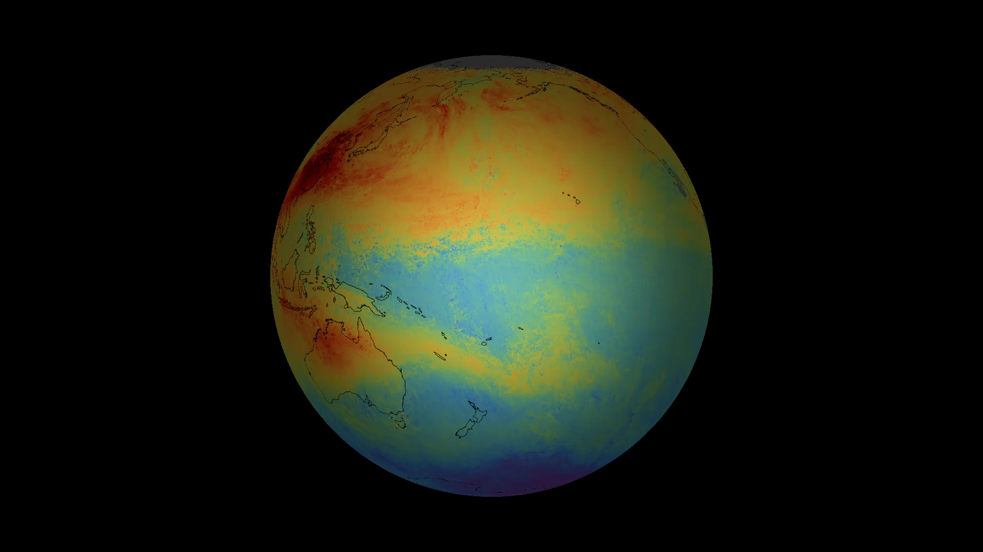
TROPOMI
CO

Slide 12
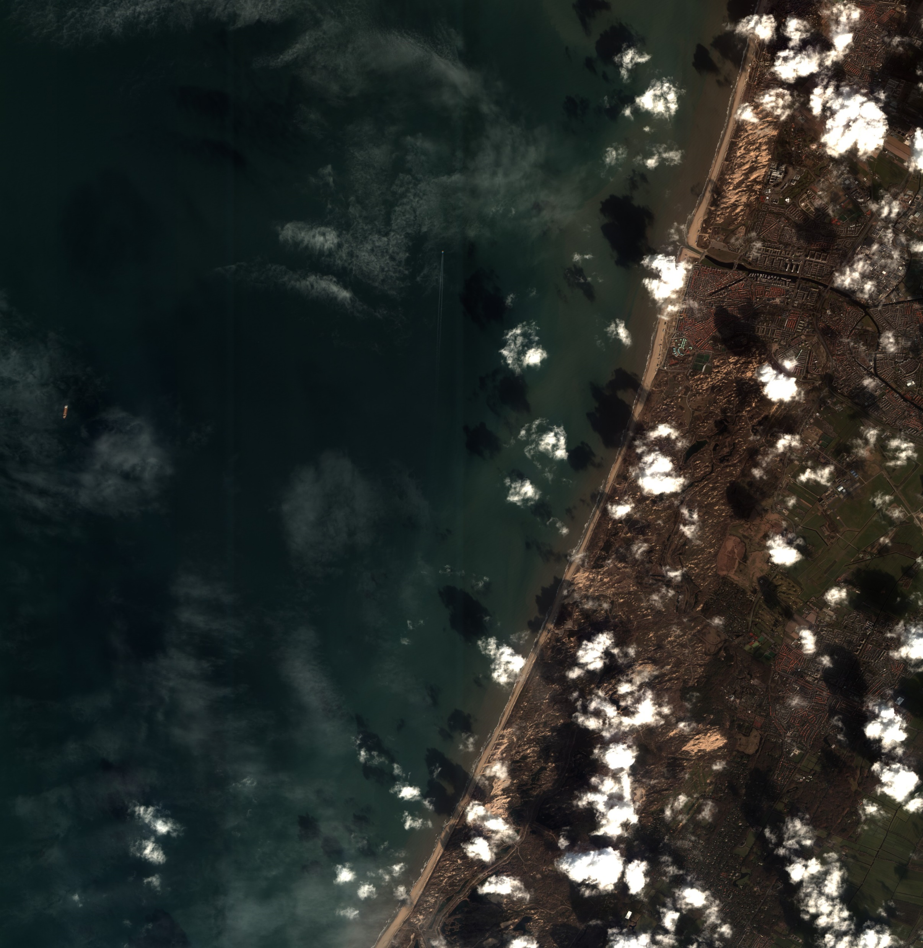
satellietdataportaal.nl
Superview:
0.5 – 2 m resolution
R,G,B,NIR, PAN

Slide 13






Land Monitoring Service
(CLMS)
Marine Environment
Monitoring Service (CMEMS)
Atmosphere Monitoring
Service (CAMS)
Emergency Monitoring
Service (EMS)
Security Service (CSS)
Climate Change Service
(C3S)

Slide 14




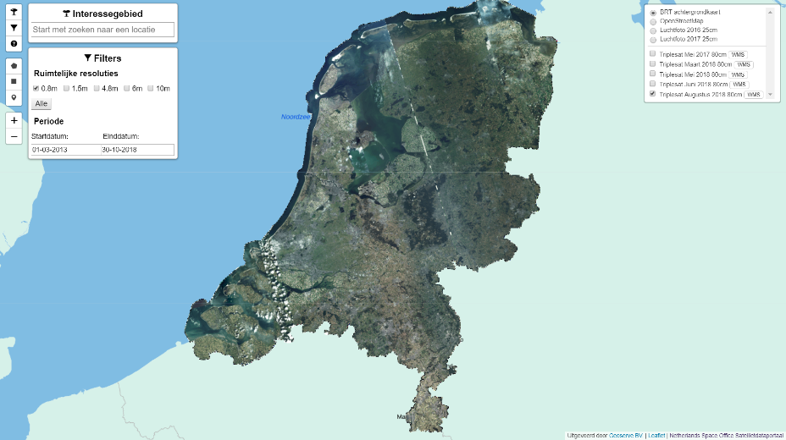

Copernicus Services
Data Hub
Open Access
Data Hub
Collaborative
Data Hub
EUMETCast
Copernicus
Online Data
Access (CODA)
Satellietdataportaal

Slide 15
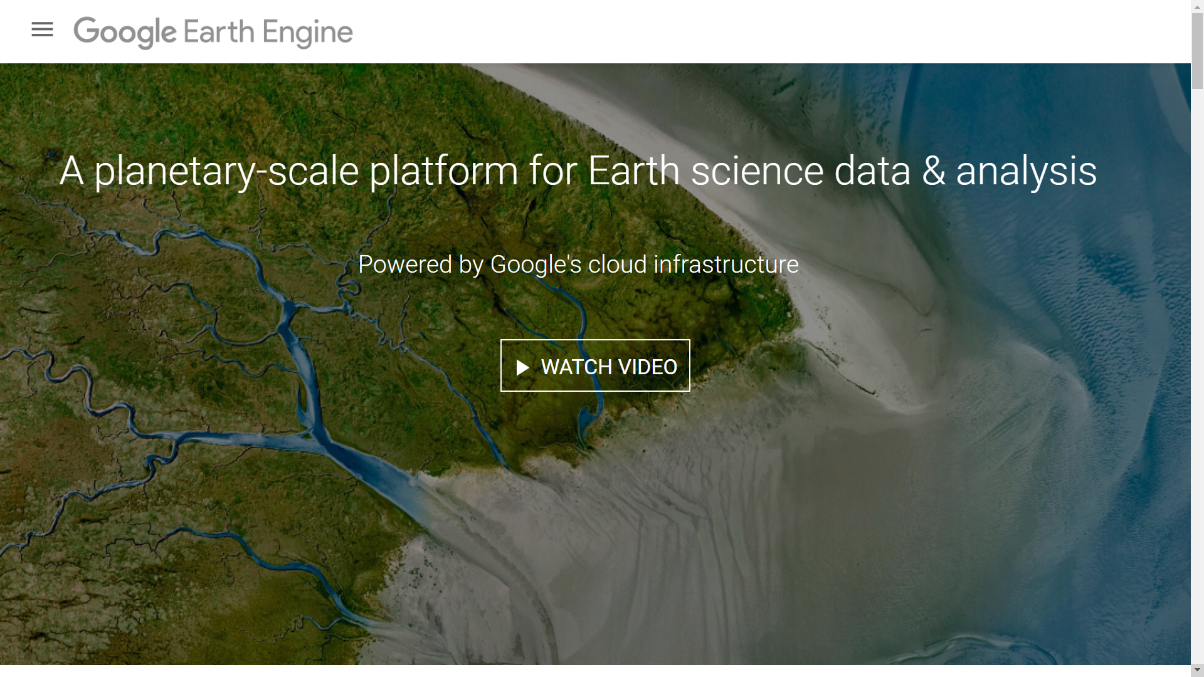
Google Earth Engine

Slide 16

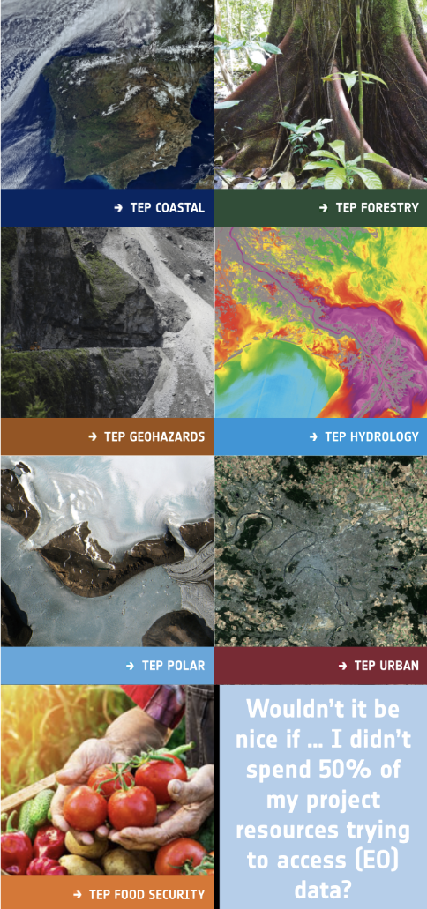


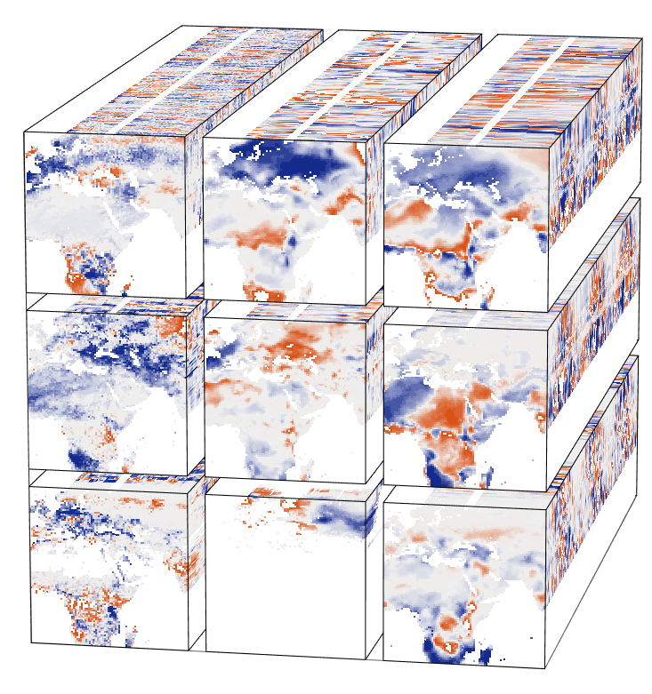


Collaborative Ground Segments
Thematic Exploitation Platforms (TEPs)
Data and Information Access Services (DIAS)
Copernicus Services
Data Hub
Open Access
Data Hub
Collaborative
Data Hub
DataCubes
EUMETCast
Copernicus
Online Data
Access (CODA)
Satellietdataportaal

Slide 17

ESA Data Cube

Slide 18
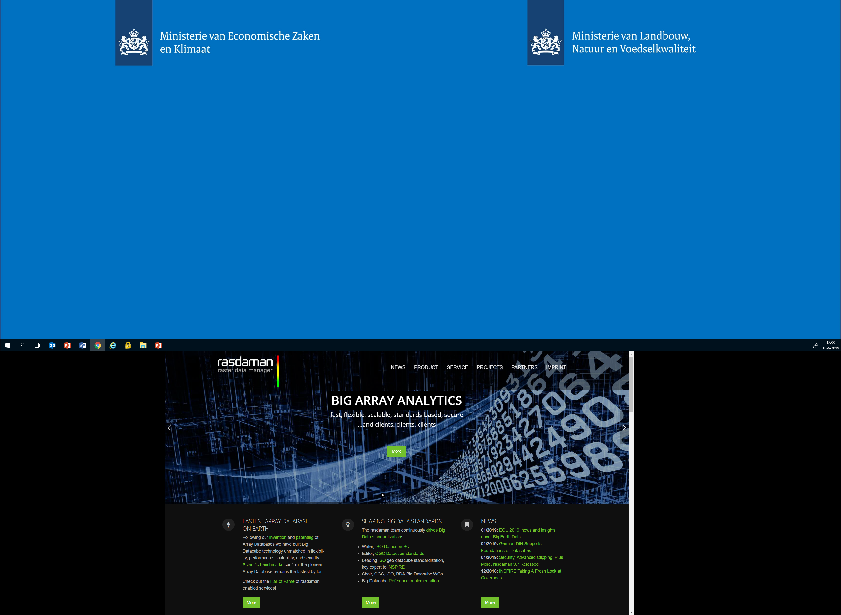
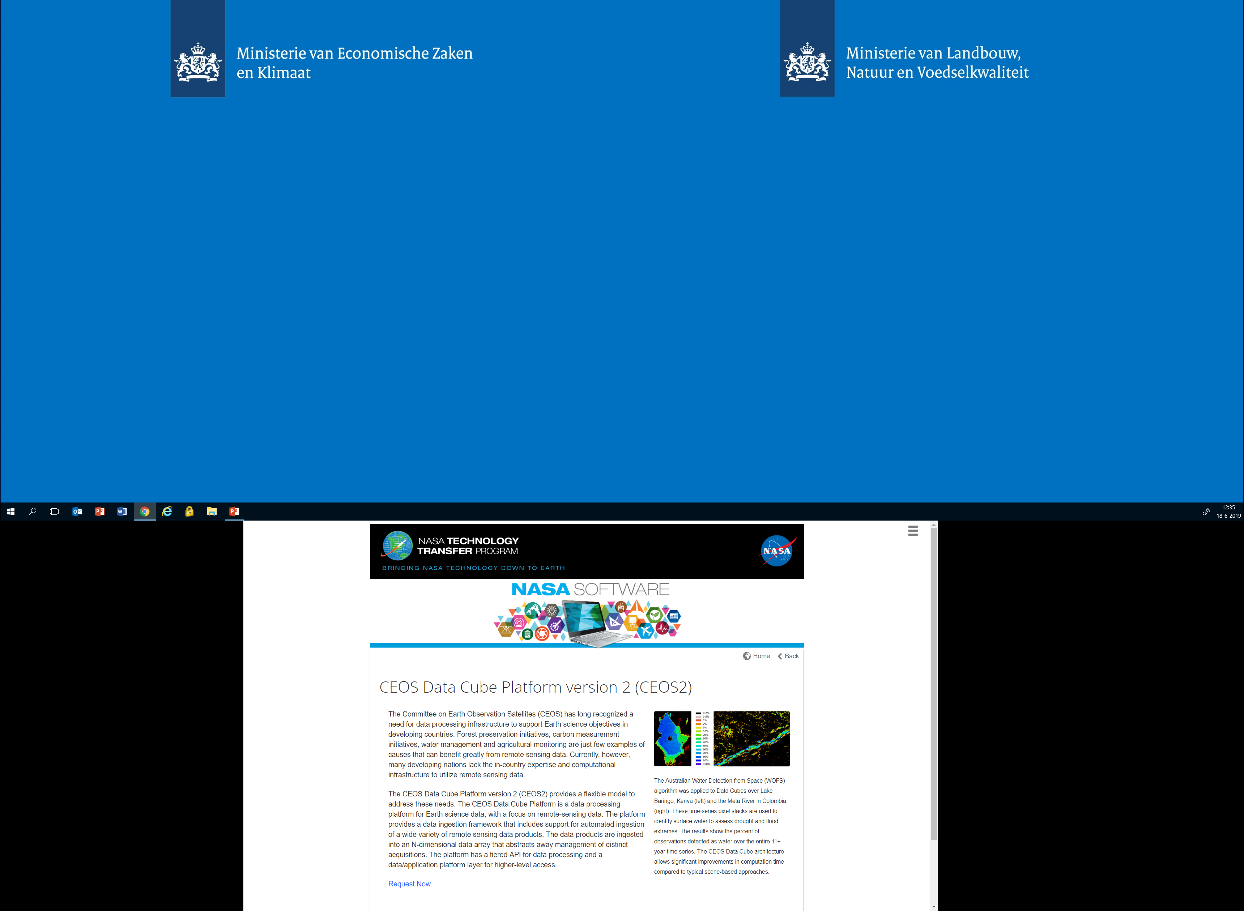
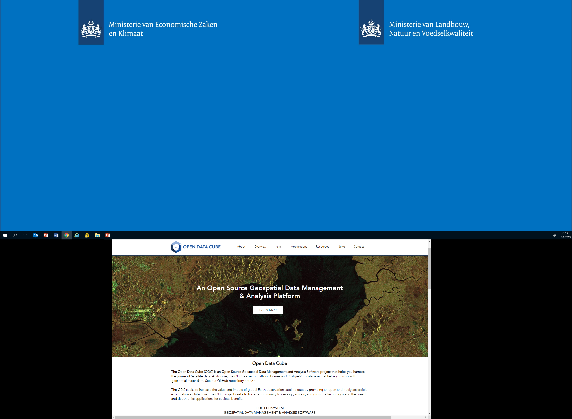
R package STARS

Slide 19
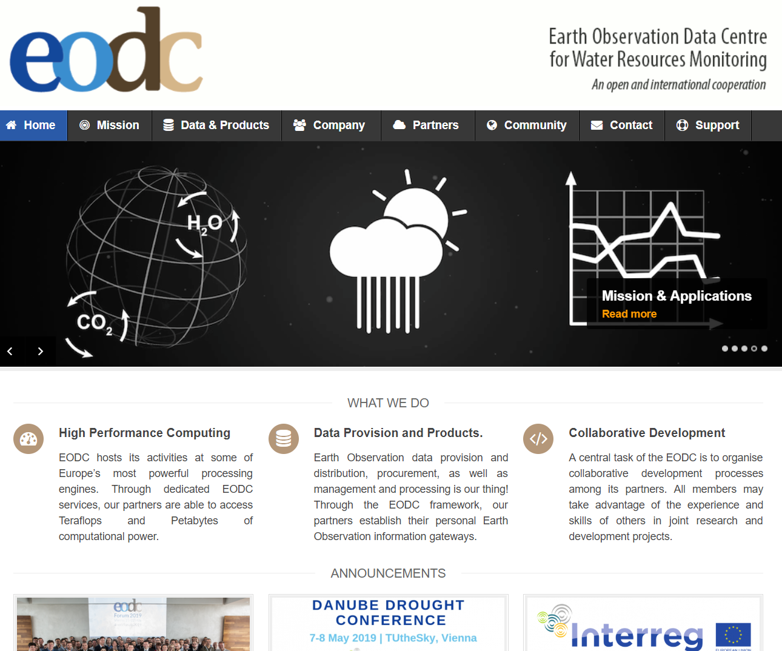
Collaborative Ground Segment
(CGS)

Slide 20
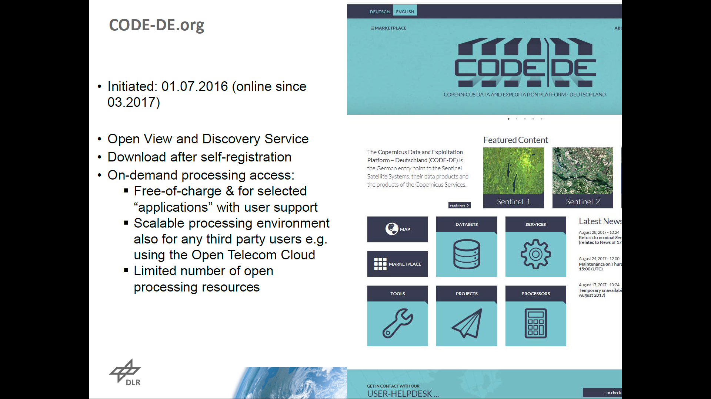
CGS

Slide 21
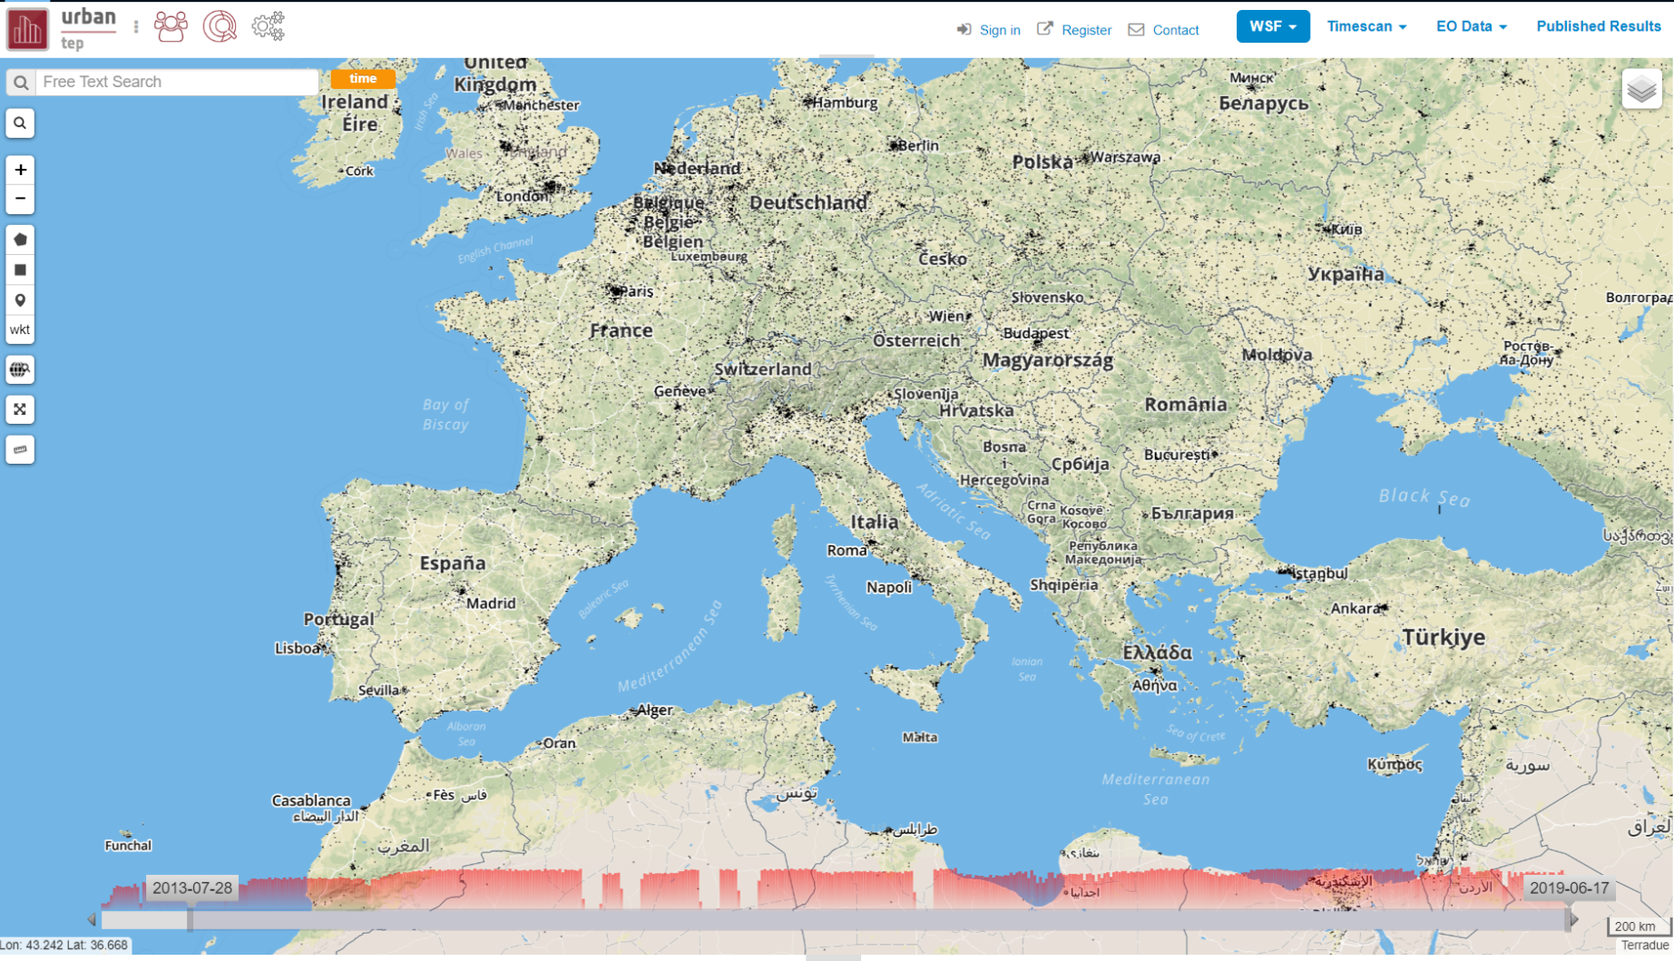

Slide 22
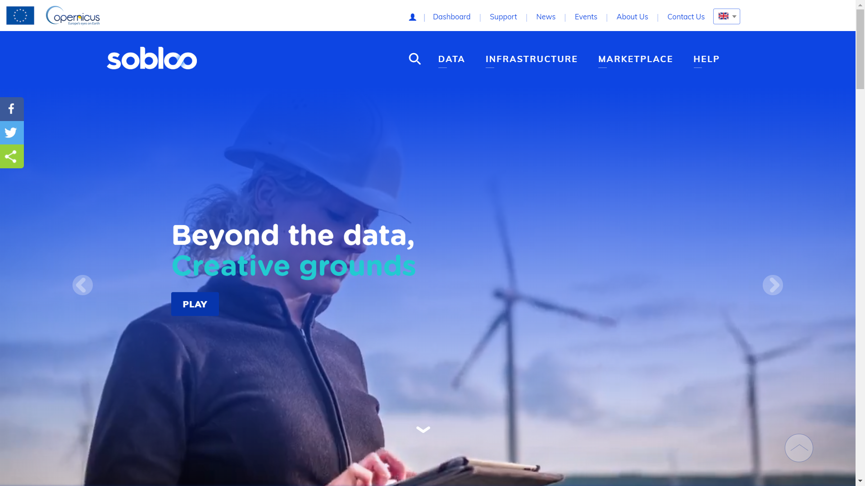

Slide 23
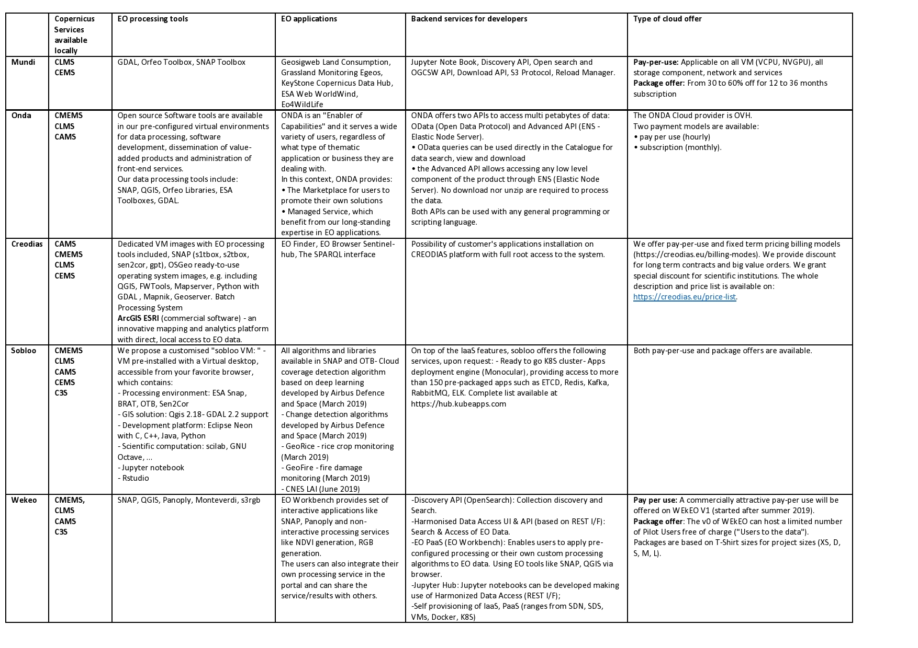
Discovery API
Open Search
OGCSW API
Odata API
Jupyter
Docker
Kubernetes
Free download access:
Sentinels
Copernicus Services
GDAL
SNAP
QGIS
FWTools
Python
Java
ArcGIS
Jupyter
Rstudio
Panoply
Search
Browse
Marketplace
Change detection
Cloud detection
NDVI
LAI
Snap
€
http://earsc.org/news/dias-comparison

Slide 24


Slide 25
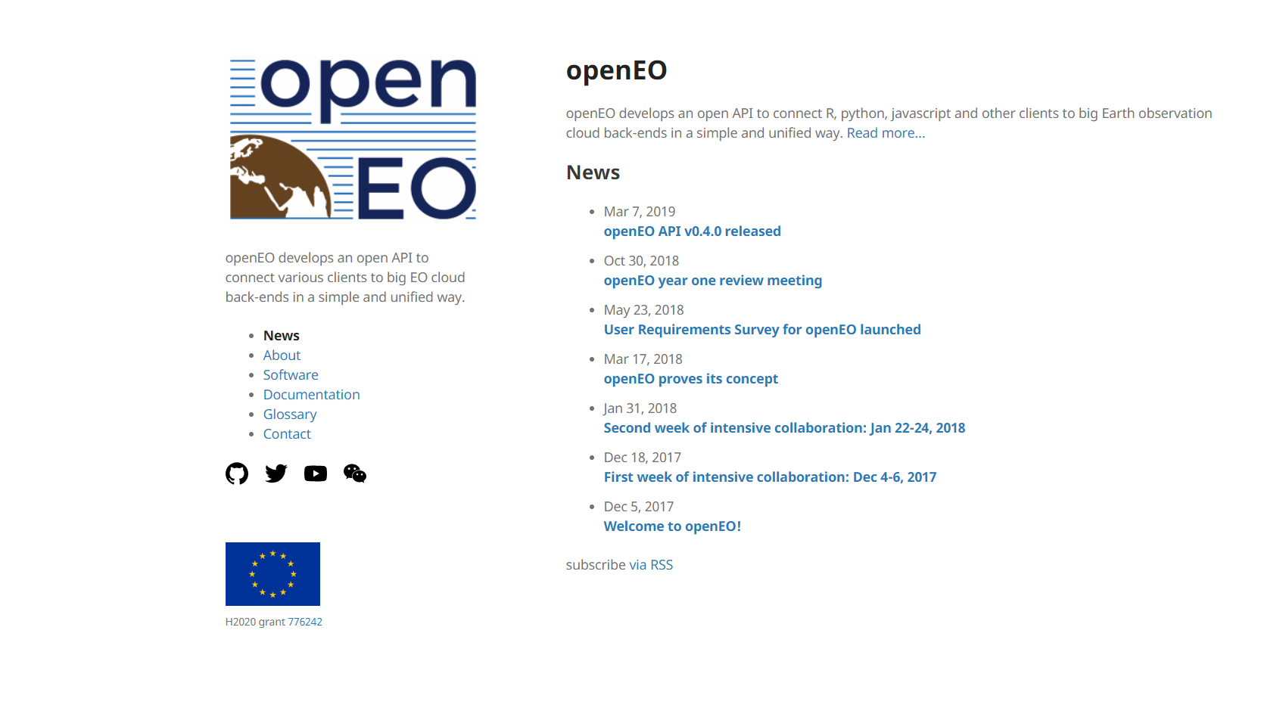
https://openeo.org/
https://edzer.github.io/prague/eo.html

Slide 26
Discussion
User experiences…
Is this too advanced? Do we need to solve other things first?
What do Dutch users need (data, infrastructure)?
Opinion on DIAS model
Contact me at r.sluiter@spaceoffice.nl !

Slide 28

Google Earth Engine

